Slide 1
Philippe Claudet (Founder)
Les Doigts Qui Rêvent 11 bis rue des Novalles 21240 Talant (suburb Dijon)
France T: (0033) 380 59 22 88
philippe.claudet@wanadoo.fr
www.Ldqr.org
www.tactus.org

Slide 2
What is to « read » a picture « tactually » ?
©Ph. Claudet, Asahi 2018

Slide 3
This is a tactile picture seen by a blind child
©Ph. Claudet, Asahi 2018

Slide 4
This is a tactile picture read by a blind child
©Ph. Claudet, Asahi 2018

Slide 5
©Ph. Claudet, Asahi 2018

Slide 6
©Ph. Claudet, Asahi 2018

Slide 7
©Ph. Claudet, Asahi 2018

Slide 8
©Ph. Claudet, Asahi 2018

Slide 9
©Ph. Claudet, Asahi 2018

Slide 10
©Ph. Claudet, Asahi 2018

Slide 11
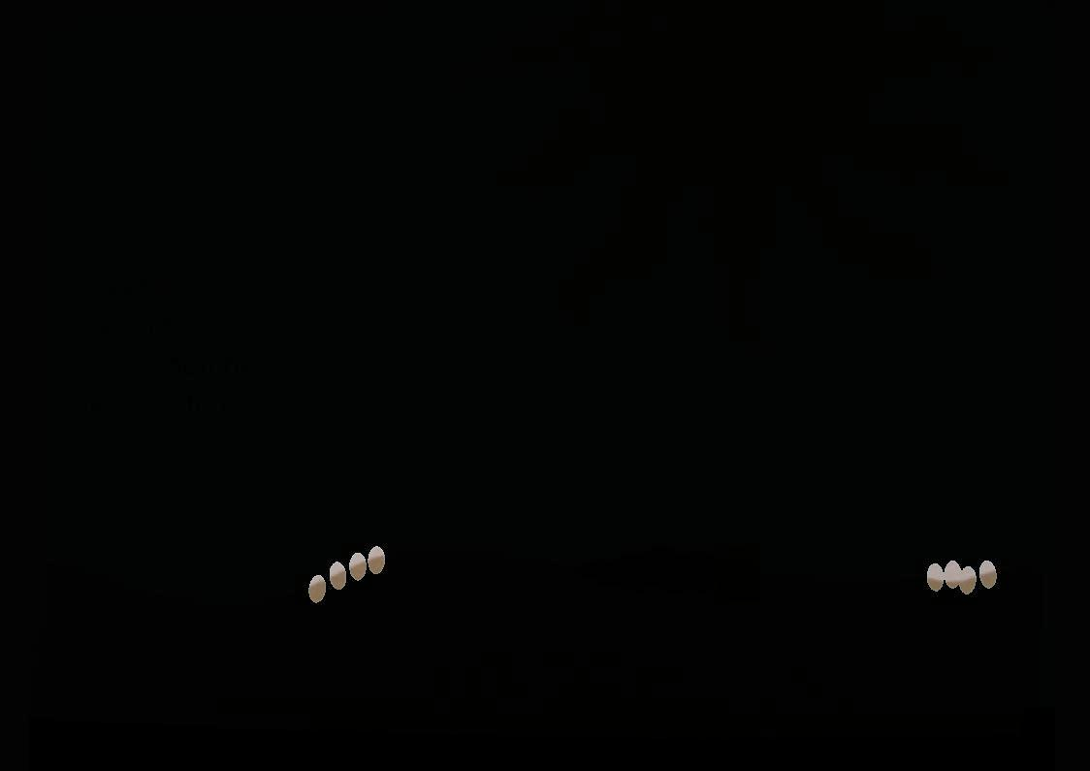
©Ph. Claudet, Asahi 2018

Slide 12
©Ph. Claudet, Asahi 2018

Slide 13
©Ph. Claudet, Asahi 2018

Slide 14
Did you guess what picture it was ?
©Ph. Claudet, Asahi 2018

Slide 15
Braille
Eric Carle, The Hungry Carterpillar, 1969 (our tactile adaptation)
©Ph. Claudet, Asahi 2018

Slide 16
© Bob Marek – Poland. 2004
©Ph. Claudet, Asahi 2018

Slide 17
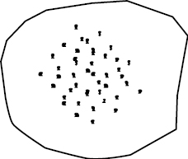
© Maria Lúcia Batezat Duarte – Brazil. 2004
©Ph. Claudet, Asahi 2018

Slide 18
©Ph. Claudet, Asahi 2018

Slide 19
tactual analogies with what…
?
tactual analogies with what…
?
©Ph. Claudet, Asahi 2018

Slide 20
^{“ Why everybody is saying}
that Tom looks like Grand-Father
since Tom is all sweet and warm
and Grand-Father is prickly and all stiff ? ”
resemblance
©Ph. Claudet, Asahi 2018

Slide 21
^{“ How can you see a big tree}
^{across a small window ? ”}
perspective
©Ph. Claudet, Asahi 2018

Slide 22
« I can hear I lost my way,
but I don’t know where I am ! »
multi-sensorial
©Ph. Claudet, Asahi 2018

Slide 23
… this is a bus
and this is a teenager in a river
©Ph. Claudet, Asahi 2018

Slide 24
Blind world
Sighted world
Ibby Athens
©Ph. Claudet, Asahi 2018

Slide 25
The Country Down the Sea
©Ph. Claudet, Asahi 2018

Slide 26
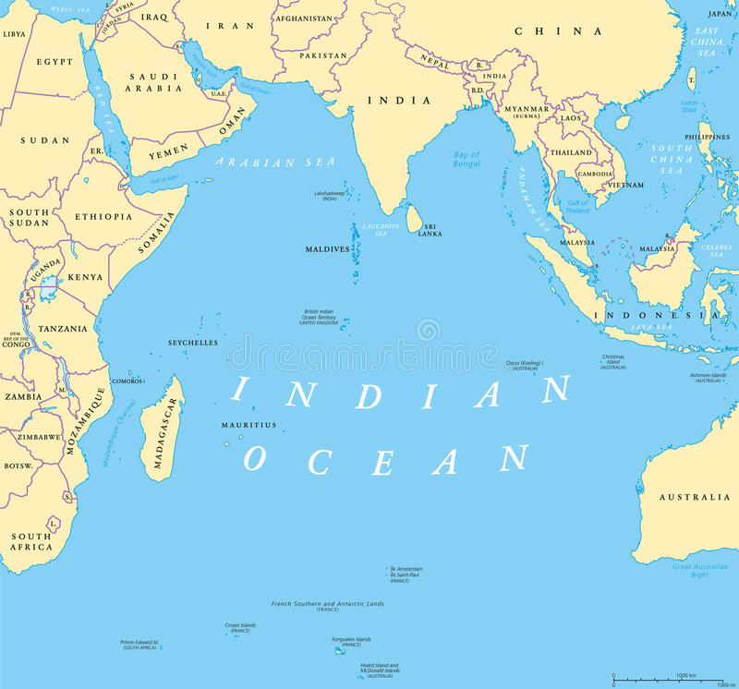
La Réunion island
©Ph. Claudet, Asahi 2018

Slide 27
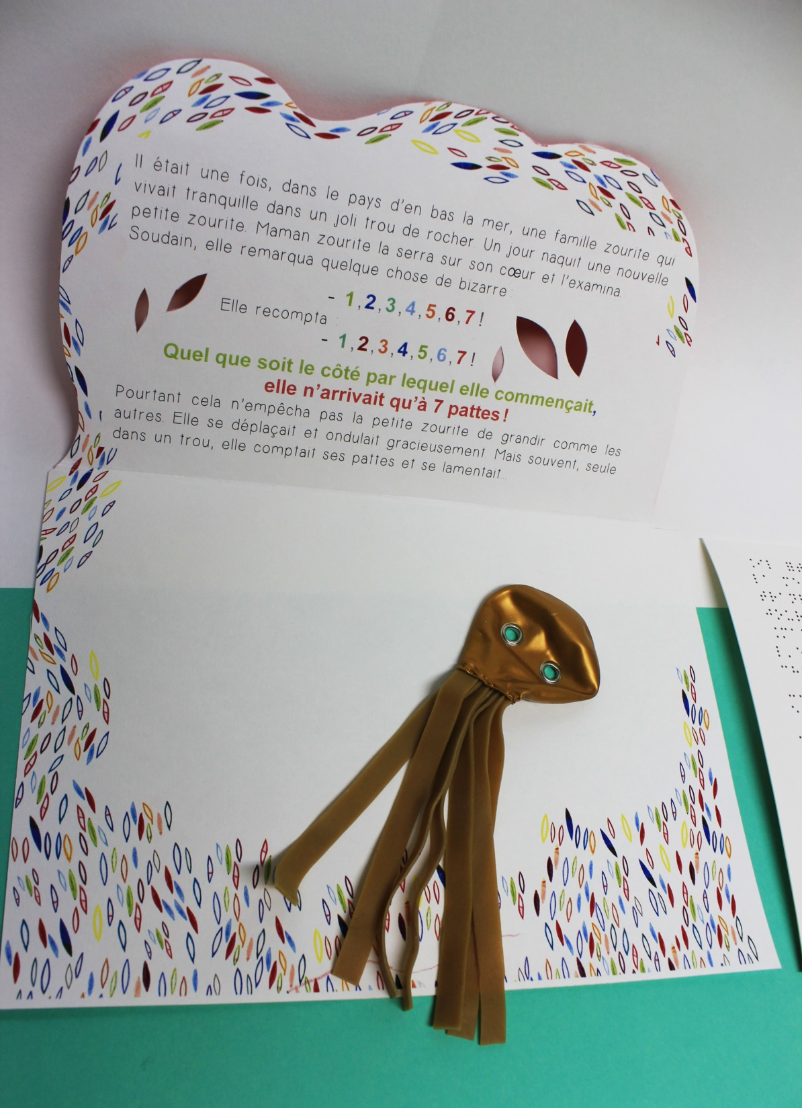
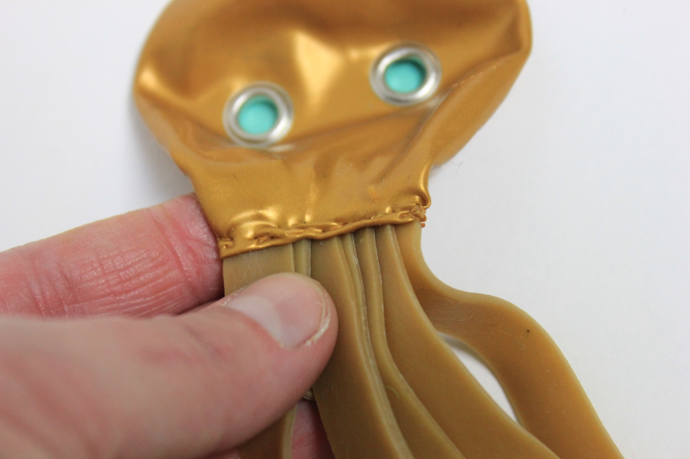
Octopus
©Ph. Claudet, Asahi 2018

Slide 28
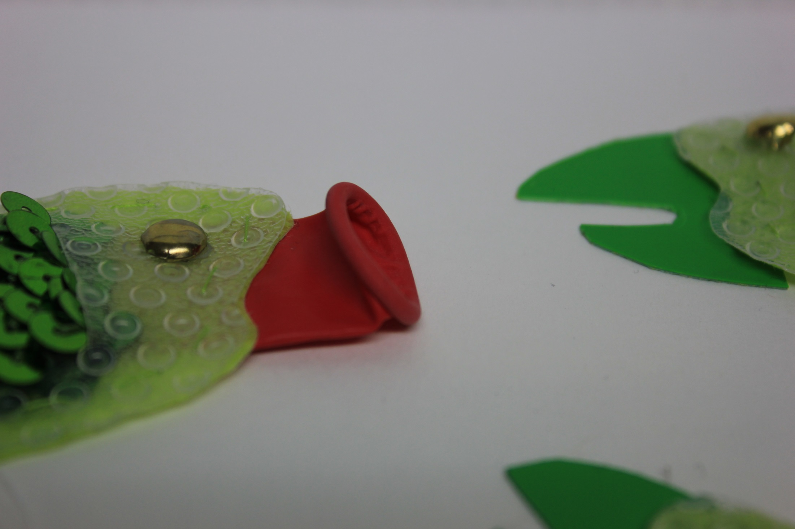
Parrot fish
©Ph. Claudet, Asahi 2018

Slide 29
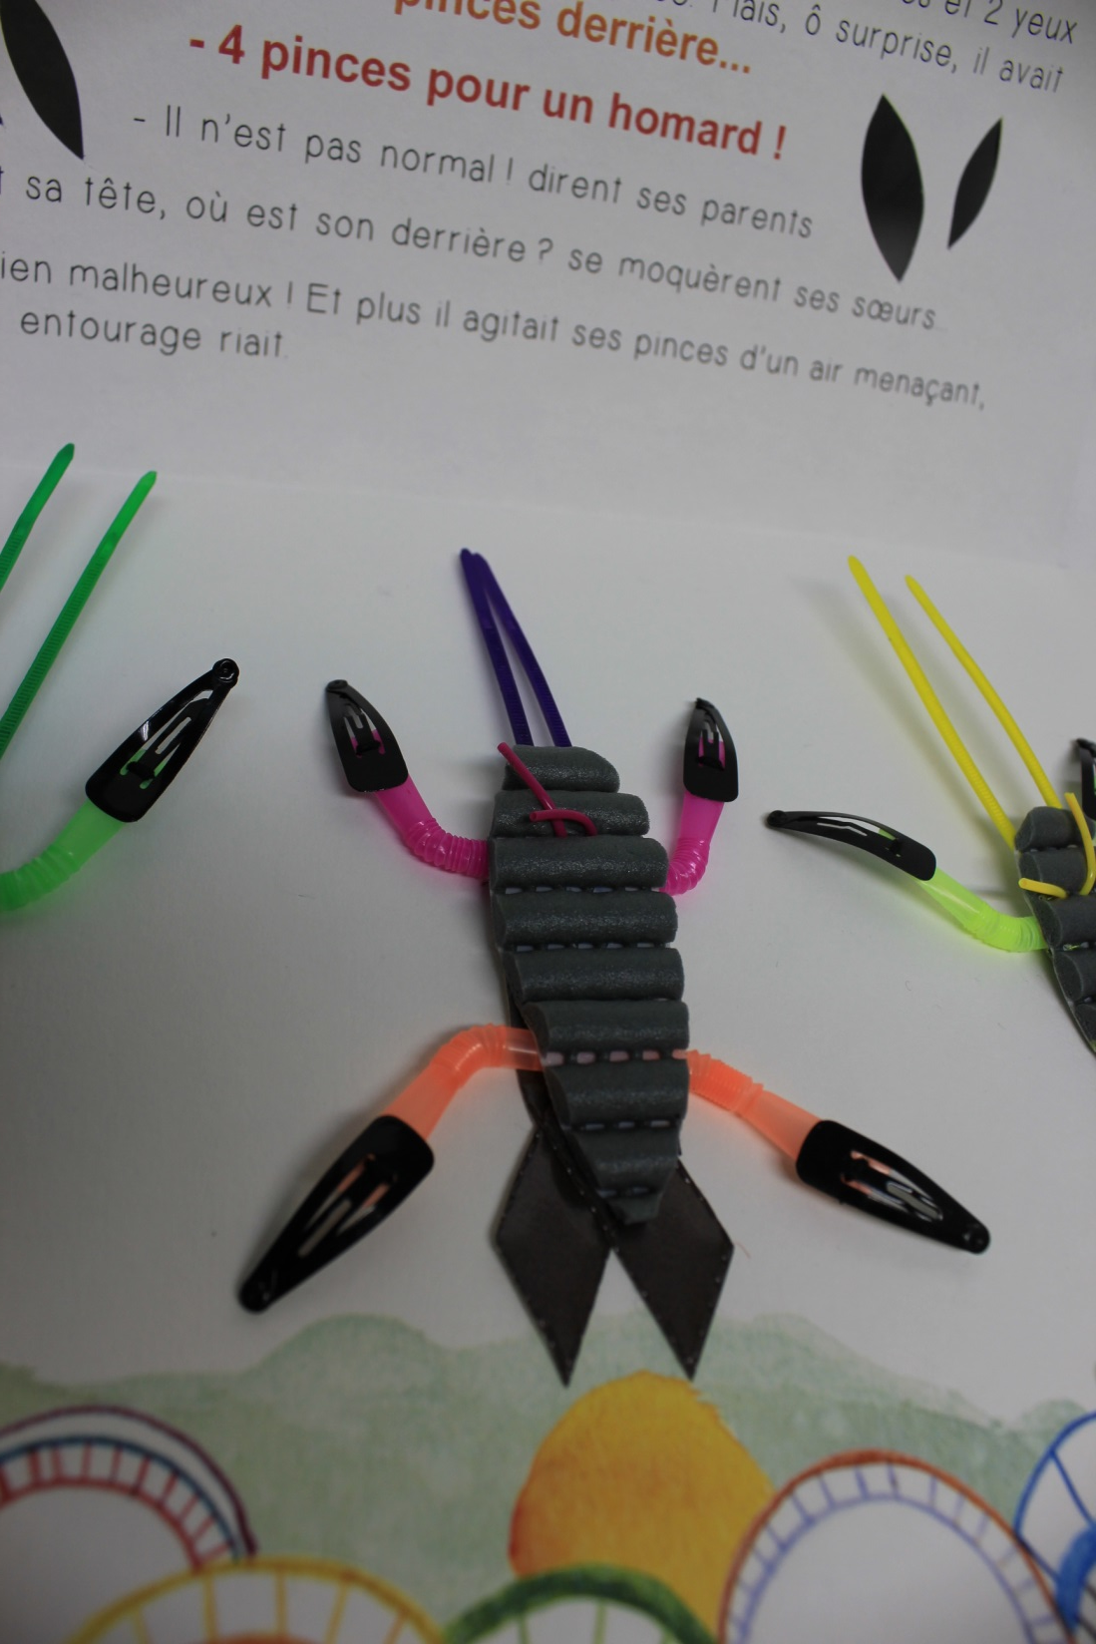
Lobster
©Ph. Claudet, Asahi 2018

Slide 30
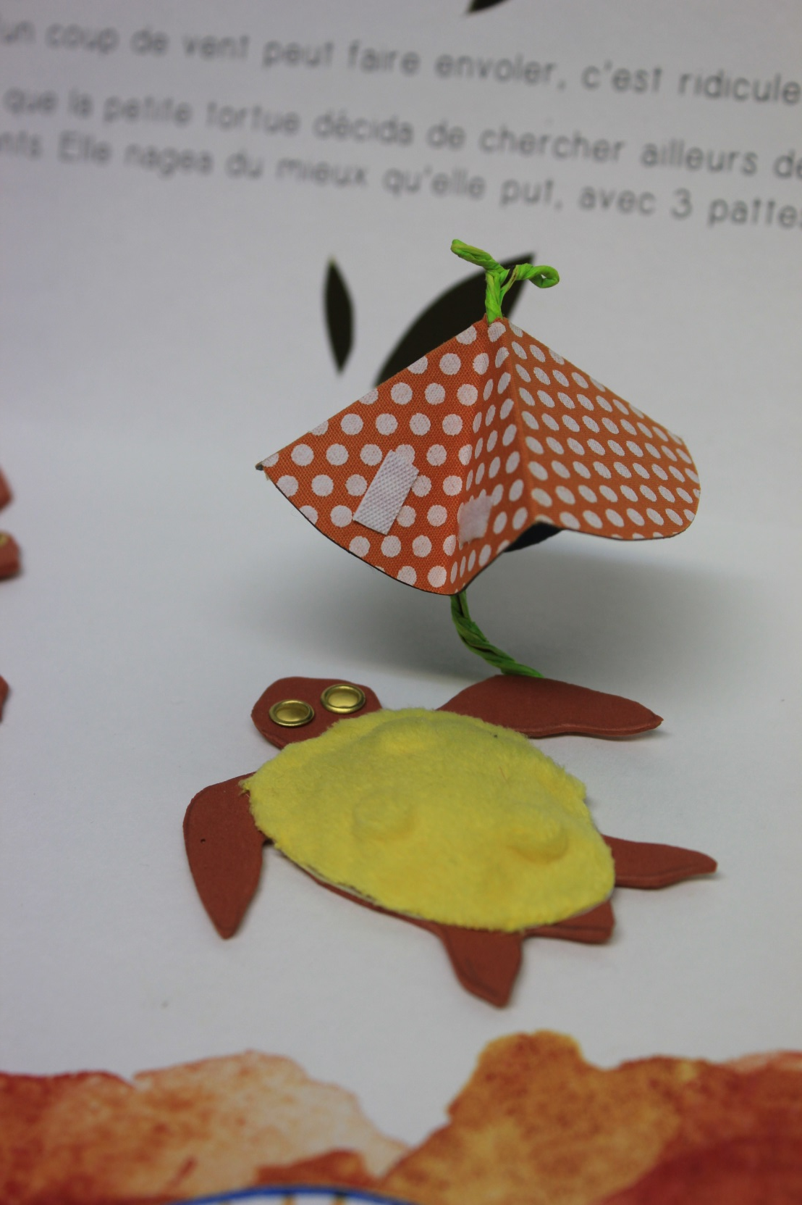
Turtle
©Ph. Claudet, Asahi 2018

Slide 31
©Ph. Claudet, Asahi 2018

Slide 32
Typhlo & Tactus the first and unique international competition for
tactile illustrated books
accessible for
visually impaired children
Since 1999 !!
Partner of ICEVI
©Ph. Claudet, Asahi 2018

Slide 33
Hei !
שלום !
Hallo !
Bonjour !
Olà !
Ciao !
Hello !
Hola !
صباح الخير
Γεια σας !
Hej !
©Ph. Claudet, Asahi 2018

Slide 34
Administration
Organizer : Les Doigts Qui Rêvent (France)
Members : Œuvre Nationale des Aveugles (Belgium, since 2000)
Hollman Foundation (Italy, ince 2000)
ClearVision (United Kingdom, since 2000)
Celia Library for the v. impaired (Finland, since 2001)
Federazione Pro Ciechi (Italy, since 2004)
Visio (Netherlands, since 2005)
Hungry Fingers (Poland, since 2005)
Stredisco Pané Recé (Czech Rep, since 2005)
©Ph. Claudet, Asahi 2018

Slide 35
Our aim
The Typhlo & Tactus (T&T) organisation has existed since 1999
to improve the quality and quantity of tactile illustrated books available
to young blind and partially sighted children with the aim of access to reading.
Participants share their ideas, knowledge and expertise, and
collaborate on production of simple story books with multi-sensory
illustrations which are fully accessible by touch.
(www.tactus.org)
©Ph. Claudet, Asahi 2018

Slide 36
Typhlo & Tactus Seeks Worldwide Contacts
The T&T group is now seeking appropriate organisations worldwide willing to act as the national contact. This will involve promoting the competition, receiving all the entries from their country, carrying out a pre-selection involving blind children and adults, and sending the five best books to the T&T competition organisers.
The most appropriate organisation to fulfil this role is likely to be a library for the blind or an organisation already involved in tactile book production, promotion or use. Each country will have just one national contact organisation, which will enter into a written agreement with Typhlo & Tactus.
For more information on the activities of the Typhlo & Tactus group and the next competition please contact Philippe Claudet (in French or English) at
philippe.claudet@wanadoo.fr
www.Ldqr.org
©Ph. Claudet, Asahi 2018
© Les Doigts Qui Rêvent 2011

Slide 37
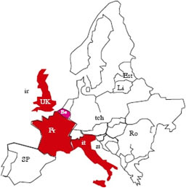
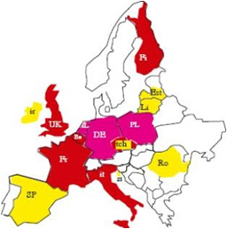
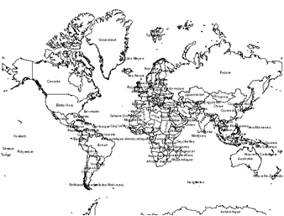
Typhlo & Tactus
2000
2005
2017
4 countries
………………………………
worldwide
©Ph. Claudet, Asahi 2018

Slide 38
Typhlo & Tactus
2000 → 2017
24 countries concerned
24 countries concerned
^{Members}
^{Belgium}
^{Finland}
^{France}
^{Italy}
^{Netherlands}
^{Poland} ^{U. Kingdom}
^{Czech Rep.}
^{Working Gpe}
^{Spain}
^{Ireland}
^{Lithuania}
^{Estonia}
^{New Zealand}
^{Members}
^{Belgium}
^{Finland}
^{France}
^{Italy}
^{Netherlands}
^{Poland} ^{U. Kingdom}
^{Czech Rep.}
^{Working Gpe}
^{Spain}
^{Ireland}
^{Lithuania}
^{Estonia}
^{New Zealand}
Workshops
^{Lithuania}
^{Estonia}
^{Romania}
^{Slovenia}
Intern. Colleagues Australia USA Japan Korea Croatia Quebec South Africa
Workshops
^{Lithuania}
^{Estonia}
^{Romania}
^{Slovenia}
Intern. Colleagues Australia USA Japan Korea Croatia Quebec South Africa
T&T exhibitions
^{Marburg}
^{Rome, Venice, Bologna}
^{South Africa}
T&T exhibitions
^{Marburg}
^{Rome, Venice, Bologna}
^{South Africa}
©Ph. Claudet, Asahi 2018

Slide 39
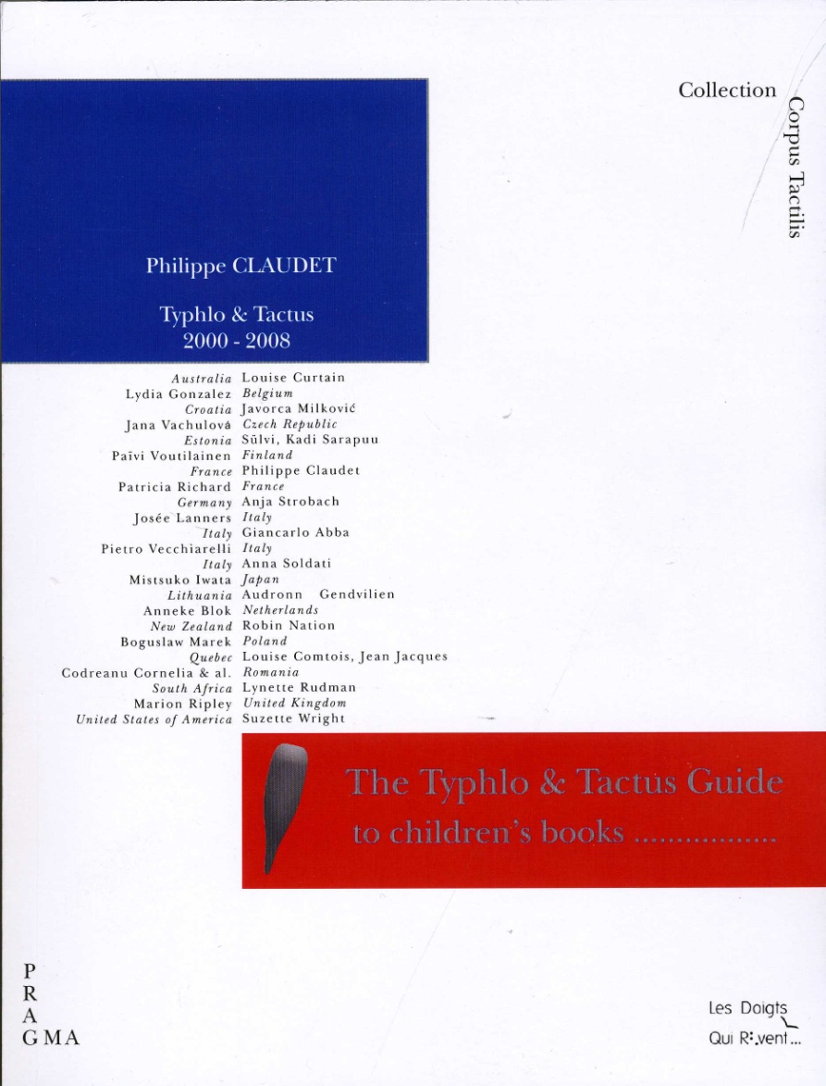
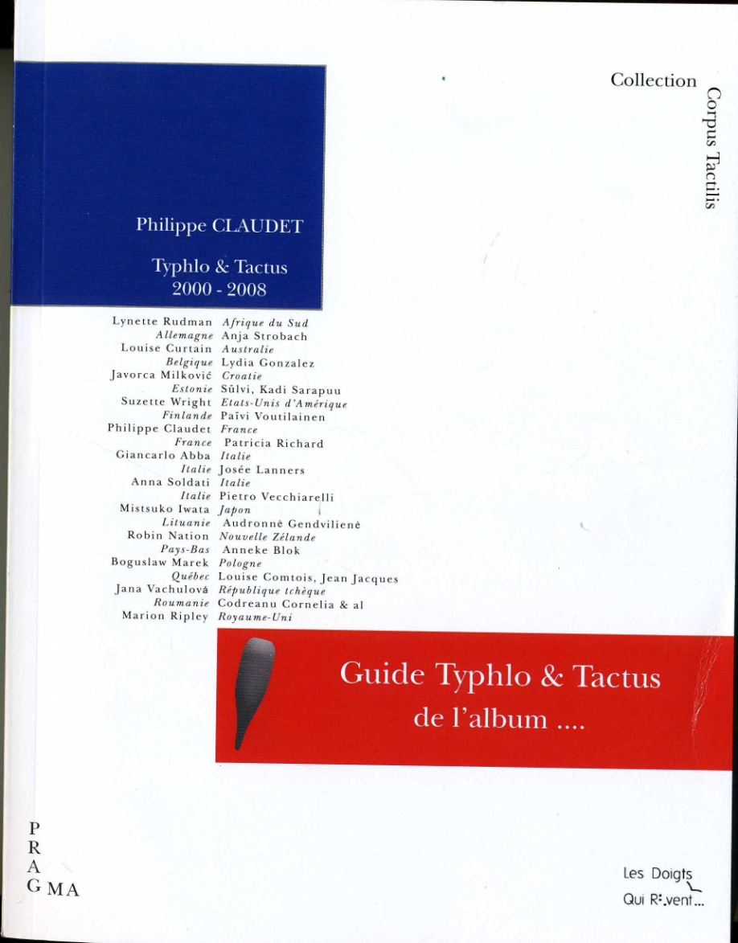
The Typhlo & Tactus Guide
to children’s books with tactile illustrations
Le Guide Typhlo & Tactus
de l’album tactile illustré
- Size: 16 x 21 cm
- 400 pages
- 22 articles
- 20 countries
-Pictures
The largest international panorama about TiB ever proposed You can order at www.tactus.org
©Ph. Claudet, Asahi 2018

Slide 40
Typhlo & Tactus summary
2000 → 2017
800 entries
19 awarded entries
7 689 tactile books produced (in 7 languages) and distributed all over Europe at 15,25€
27 800 posters distributed in Europe
©Ph. Claudet, Asahi 2018

Slide 41
Do you create
tactile illustrated books
for
visually impaired children ?
Are you teacher, early interventionist, parent, caregiver, librarian, artist ?
©Ph. Claudet, Asahi 2018

Slide 42
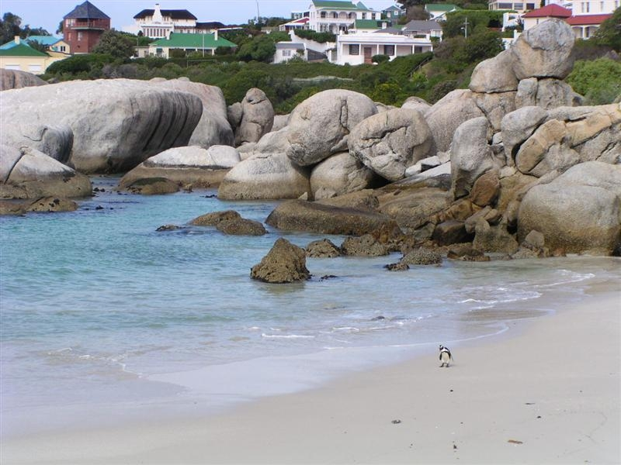
Don’t stay isolated….
like him !
©Ph. Claudet, Asahi 2018

Slide 43
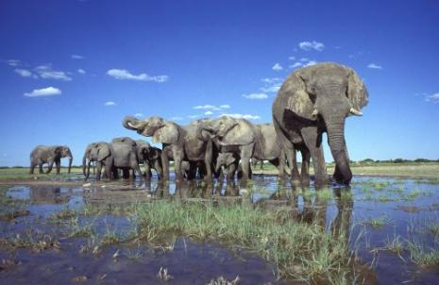
Join Tactus …. ! Together we are better and stronger !
©Ph. Claudet, Asahi 2018

Slide 44
For the Tactus story 2000-2017, see http://www.tactus.org/T&T_International_Competition_to_Tactile_Books.pdf
Next competition in October 2019 ! (every 2 years)
www.tactus.org
For any further information…
philippe.claudet@wanadoo.fr
©Ph. Claudet, Asahi 2018

Slide 45
Σύντομα…
בקרוב…
See you soon…
Bald…
philippe.claudet@wanadoo.fr
قريبا
Les Doigts Qui Rêvent (Charity since 1994) Publishing house of tactile illustrated books France www.Ldqr.org
Pian…
Σύντομα
Pronto…
A bientôt…
Hamarosan…
Aviat…
©Ph. Claudet, Asahi 2018

Slide 46
Thank you for your attention
Les Doigts Qui Rêvent
11bis rue des Novalles
21240 Talant (France)
T: 0033 380 59 22 88
Ldqr@wanadoo.fr
philippe.claudet@wanadoo.fr
www.Ldqr.org
www.Tactus.org
©Ph. Claudet, Asahi 2018

