Slide 1

Philippe Claudet (Founder)
Les Doigts Qui Rêvent 11 bis rue des Novalles 21240 Talant (suburb Dijon)
France T: (0033) 380 59 22 88
philippe.claudet@wanadoo.fr
www.Ldqr.org
www.tactus.org

Slide 2
Some landmarks
1784 : First school for the blind in the world (Paris by Valentin Haüy in France)
➔NO books for visually impaired
1829 : Louis Braille creates a writting in dots for the blind
➔NO books for visually impaired children
1841 : First tactile illustrated book for blind adults in the USA
➔NO books for visually impaired children
1860-1914 : School for the blind openings all over the world
➔NO books for visually impaired children
1975: French law: educational obligation in special institutes for handicapped children
➔NO books for visually impaired children
1990’s : Parents try to integrated their v. i. children in mainstream schools
➔Rare books for visually impaired children
1991 : American Printing House for the Blind published the 1^{rst} TiB in the USA (500 copies)
➔Tactle illustrated books for visually impaired children (thermoform)
1994 : Les Doigts Qui Rêvent is created (as a nonprofit organization)
➔Tactile illustrated books for visually impaired children in France (collage)
1999 : Les Doigts Qui Rêvent organized the 1^{rst} international meeting about TiB
2000: Les Doigts Qui Rêvent settled Tactus, the 1^{rst} international competition of TiB
➔Tactile illustrated books for visually impaired children in Europe
2005: French law: compulsory school to integrate v. i. children in mainstream schools
➔Supply of Tactile illustrated books for visually impaired children
©Ph. Claudet, Asahi 2018

Slide 3
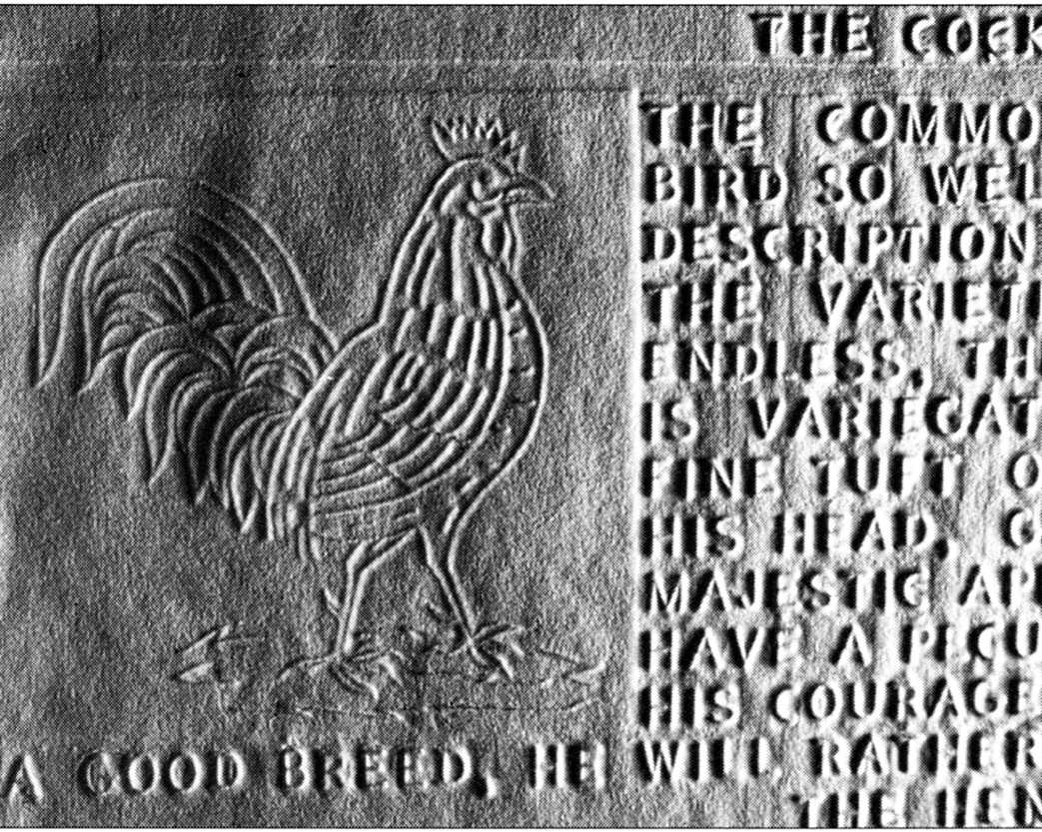
Embossing on thick paper
A Pep into the Menagerie of Birds, John Alston Press, Glasgow, 1841
©Ph. Claudet, Asahi 2018

Slide 4
CONTEXT
Before, during and after the 90’s
➔ FAMINE book for visually impaired children all over the world
How to teach reading and writing without books!
1993: A teacher for visually impaired + some parents decided to react
and settled a nonprofit professional publishing house that is
Les Doigts Qui Rêvent (Dreaming Fingers)
©Ph. Claudet, Asahi 2018

Slide 5


PRECAUTION
Any impairment (for example blindness)
No answer from the society (for ex, no books)
HANDICAP
➔ impairment is on a person
➔ handicap depends on a society
©Ph. Claudet, Asahi 2018

Slide 6
PRECAUTION
Our target ➔visually impaired
= blind children
= partially sighted children (without other disabilities)
= partially sighted children (with other disabilities, p. ex. prematurity)
+ partially sighted parents
+ blind parents
+ sighted parents
We do TiB for all children
AND / BUT
all our TiB are accessible to visually impaired
©Ph. Claudet, Asahi 2018

Slide 7
Our missionS (since 1994)
➔To give reading access to partially sighted and blind children
1-before learning to read
(= Early Literacy)
2-when learning to read
(= 1^{rst} & 2nd Grade)
➔To give useful information to parents and professional
➔To produce in solidarity economy (to not exploit anyone)
➔To cooperate with other oragnizations and countries
➔To help other countries (as much as possible)
➔To engage research about tactile pictures and perception
©Ph. Claudet, Asahi 2018

Slide 8
Our actionS
-Creation, adaptation, production of TiB
-Book fairs for youth literacy
-Workshops for children
-Conferences
-Research
-International projects: Typhlo & Tactus ; BiTiB
+ ask, claim, demand… and then cry and beg for financial help…
©Ph. Claudet, Asahi 2018

Slide 9
Why TiB? (1/2)
Nothing around a visually impaired concerning early literacy
➔ How to teach reading awareness without books ?
How to teach/learn to read without books ?
Books help to share the same culture (language, fairy tales…)
To learn to read is a Human Rights
Visually impaired children have the SAME RIGHTS as all the children
©Ph. Claudet, Asahi 2018

Slide 10
Why TiB? (2/2)
Writting awareness
Pleasure
Links between parents (Sighted/Blind) with children (Blind/Sighted)
To associate pleasure & books where Braille
To develop the tactile sensitivity
To help the relationship between Sighted & Blind
To learn to name the world
To bring what is too small, too big, too dangerous (out of touch)
To learn what is a picture (= re-presentation)
etc…….
©Ph. Claudet, Asahi 2018

Slide 11
Specificic of a TiB
Made by sighted adults for visually impaired children
No ONE Blindness but several (from birth, late…)
No ONE Visual impairment, but many
Nowadays mainly with other disabilities
= M i N O R i T Y
Sighted professional for visually impaired are not writer or artist
Our TiB are made to be accessible to sighted and to visually impaired (book sharing)
©2018, Ph. Claudet
Creation or adaptation from commercial picture books
©Ph. Claudet, Asahi 2018

Slide 12
What do we publish?
For children:
Early literacy ( 0-5)
Educational Tactile Illustrated books
Fabric Tactile Illustrated books
Beginner reader (6)
Tactile Illustrated books (story books)
Tactile alphabet books
Reader
Tactile Illustrated books
Artist Tactile illustrated books
For sighted adults: (parents and professional)
Essays and guides from abroad
©Ph. Claudet, Asahi 2018

Slide 13
Key-points of our TiB
2 writings : large print & Braille (Grade 1)
-Large print for partially sighted and sighted
-Braille for blind
➔our books can be shared by sighted and visually impaired (integration)
Contrasted colours to stimulate residual sight
Pictures in relief (by collage 90%) (based on research, textures are the main clue for recognition)
Binding providing full horizontal pages (necessary for tactile reading)
Shall give a positive « image » of the visually impaired children
Shall be visually esthetic and tactually efficient
Shall help the child’s social integration / inclusion
… and be as cheap as possible !!!
©Ph. Claudet, Asahi 2018

Slide 14
What kind of books do we publish ?
©Ph. Claudet, Asahi 2018

Slide 15
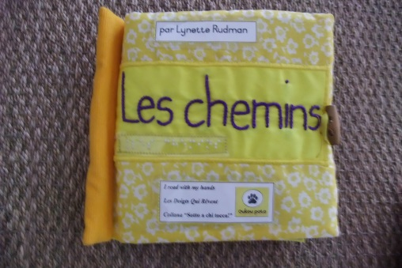
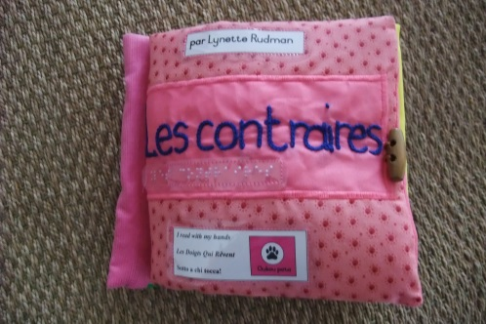
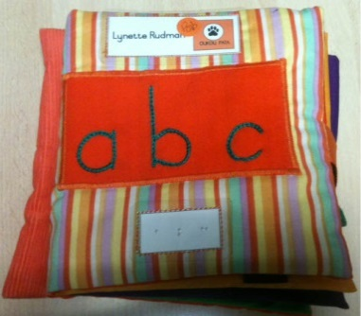
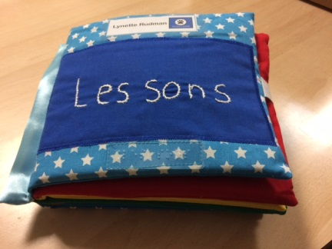
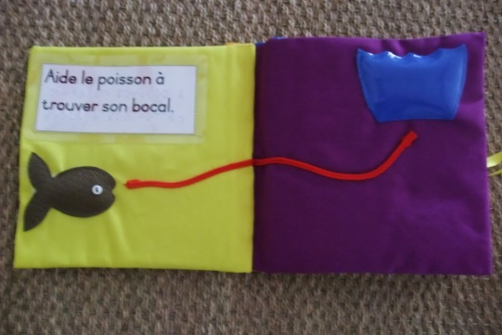
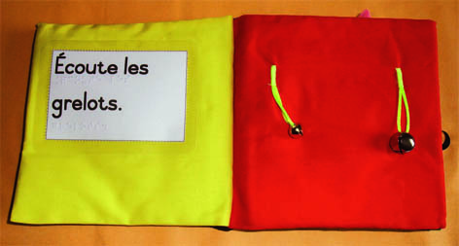
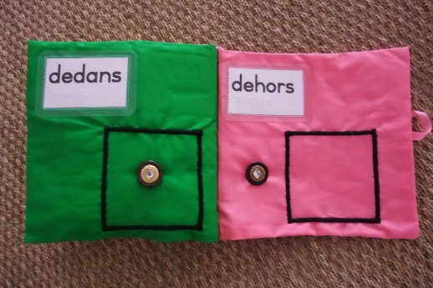
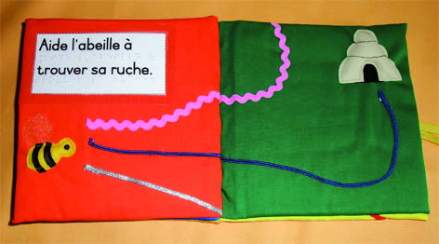
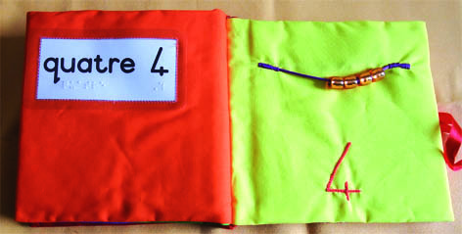
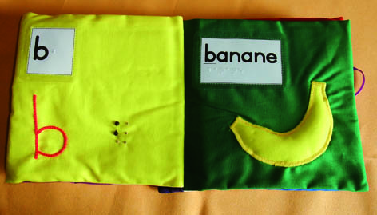
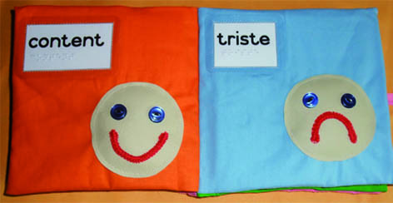
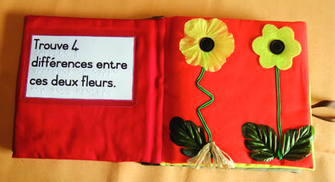
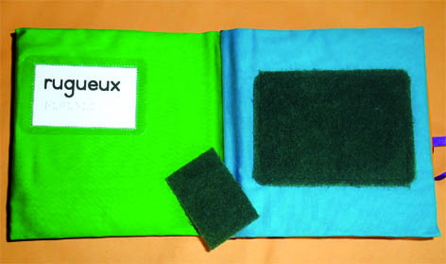
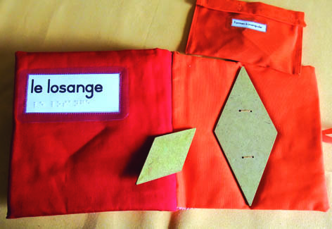
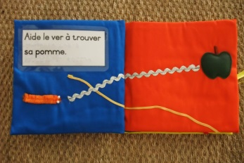
1-Fabric TiB (author, Lynette Rudman, Sth Africa)
©Ph. Claudet, Asahi 2018

Slide 16
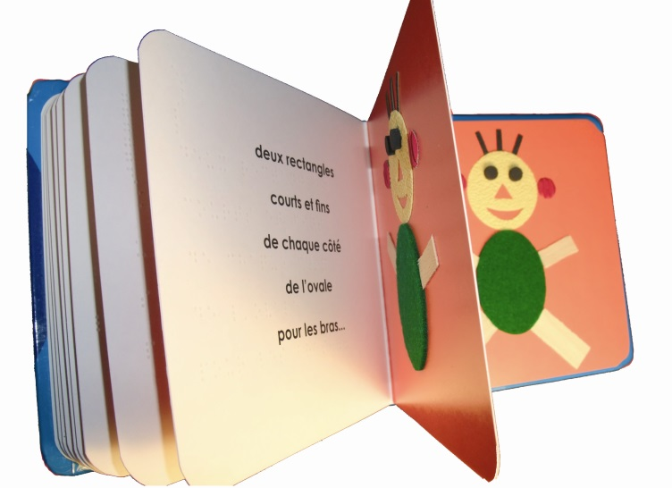
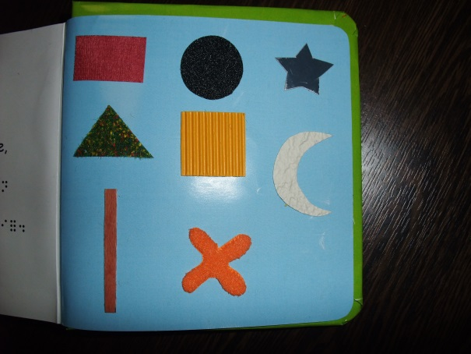
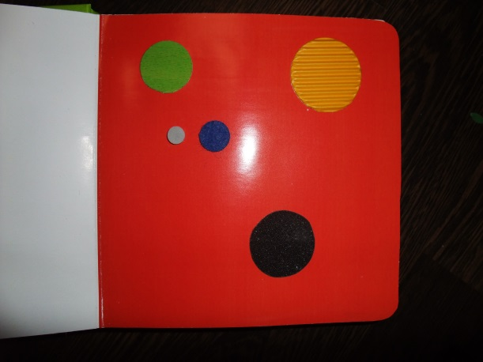
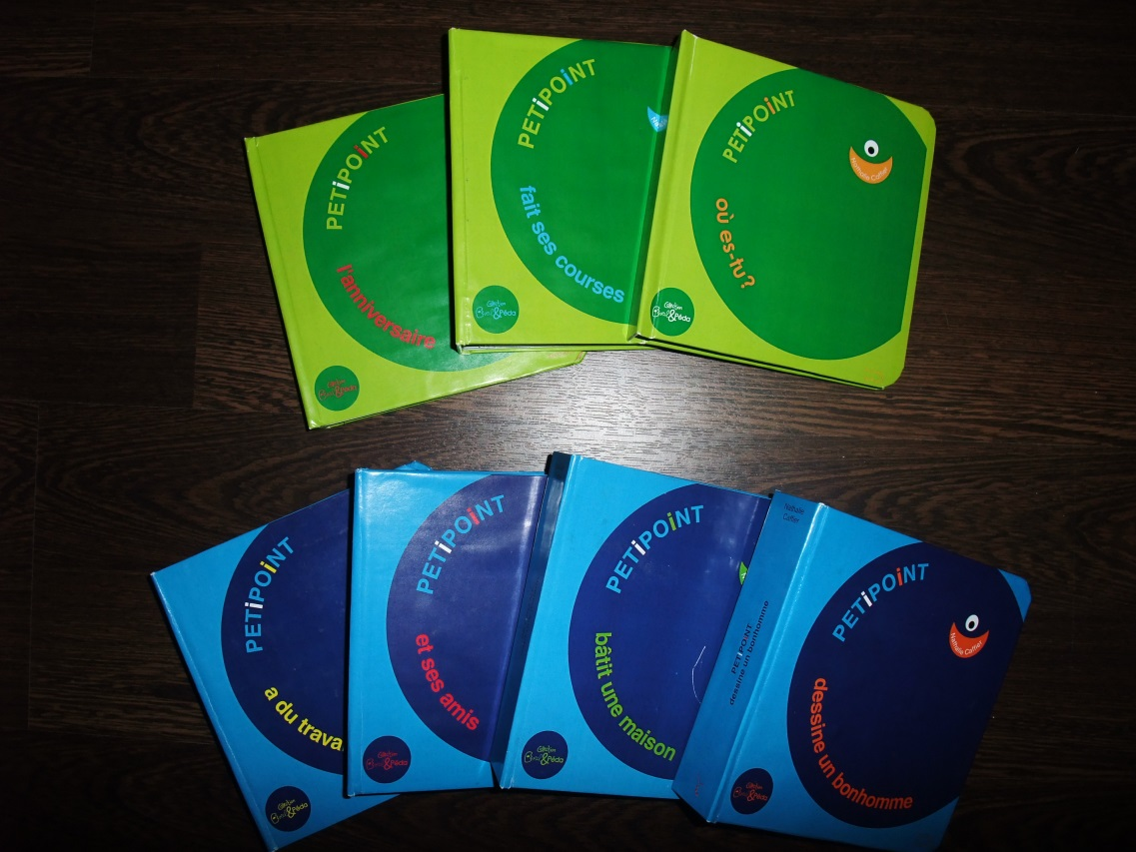
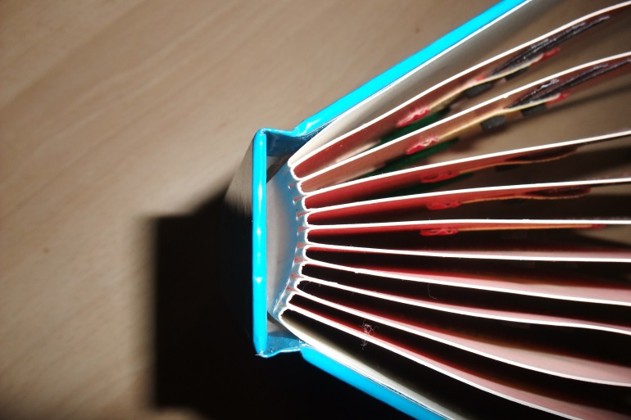
2-Educational TiB
16x16cm (6x6 inches)
Binding without spiral
©Ph. Claudet, Asahi 2018

Slide 17
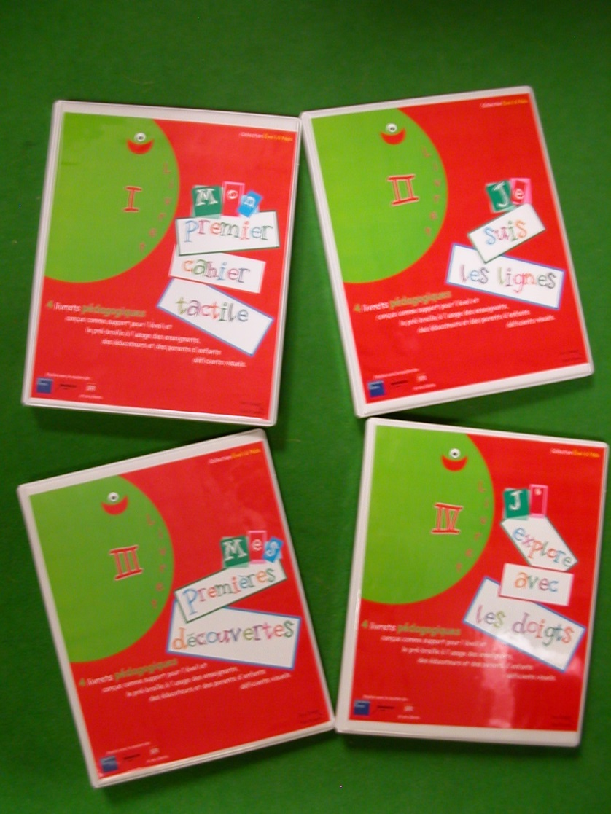
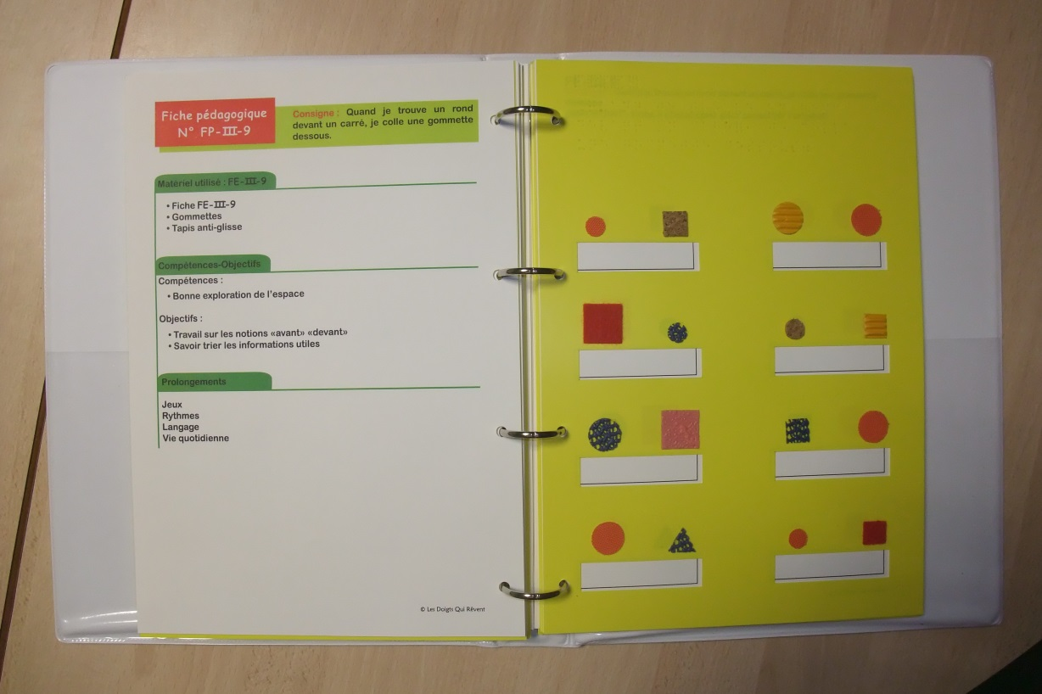
3-Pre-school TiB
For the sighted teacher of a mainstream class
to stick labels
Ldqr, 2008 21x29,7cm (8.5 x11.5 inches) 16 sheets
For the blind child
©Ph. Claudet, Asahi 2018

Slide 18
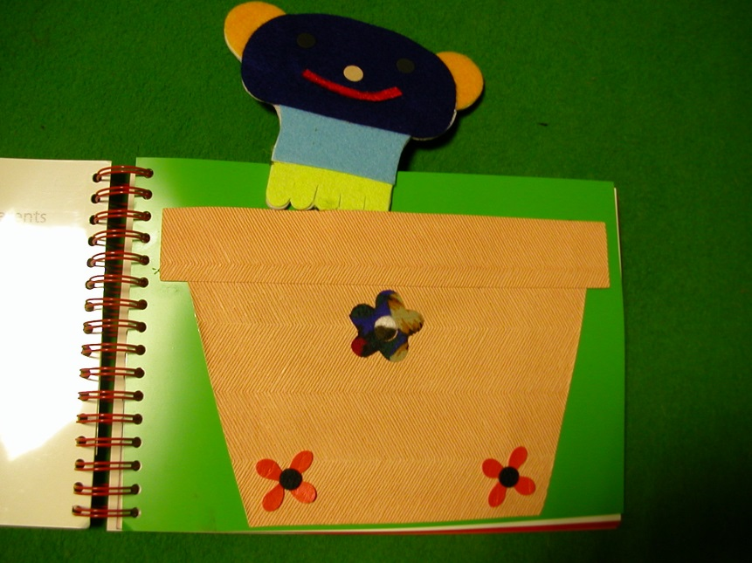
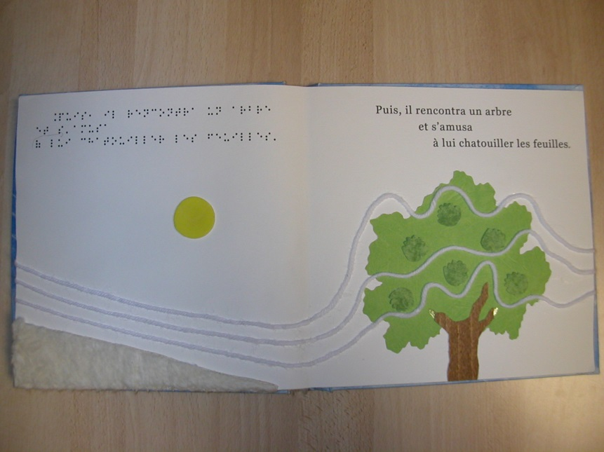
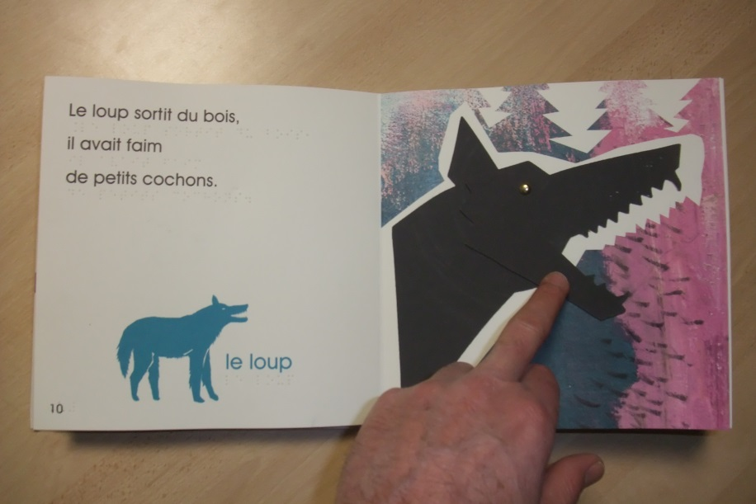
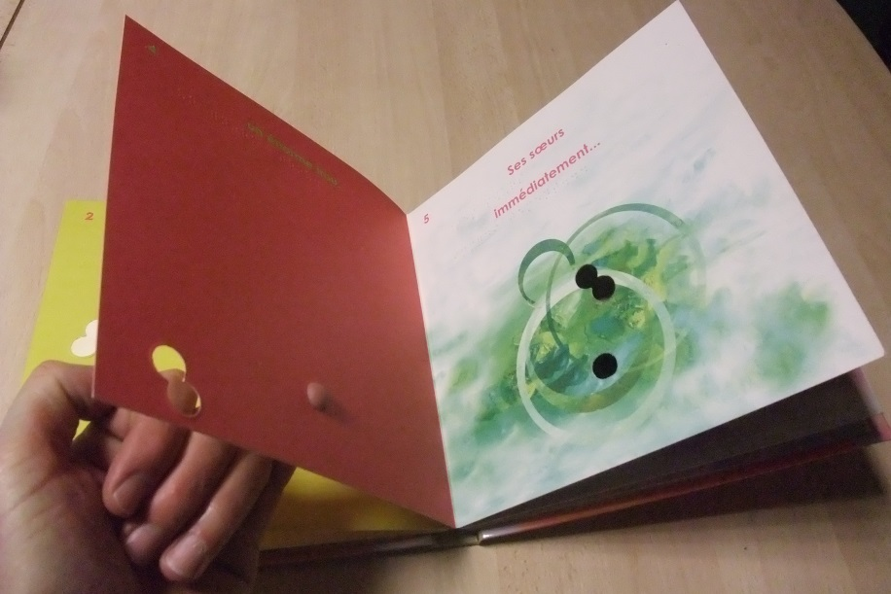
4-Youth literacy TiB (no reader)
Ldqr, 2000, 2010, Crokato, French author
Ldqr, 2008, Little breath of wind, Italian author
©Ph. Claudet, Asahi 2018
Ldqr, 2011, 3 little pigs, French author
Ldqr, 2011, Naughty little hole, English author

Slide 19
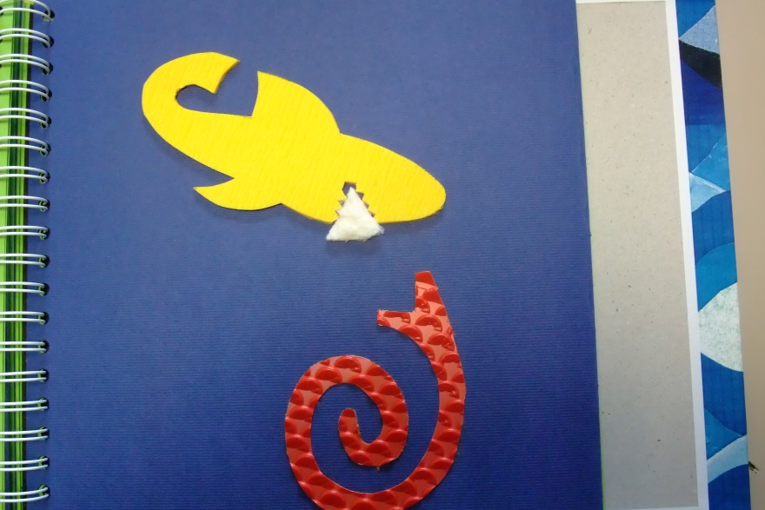
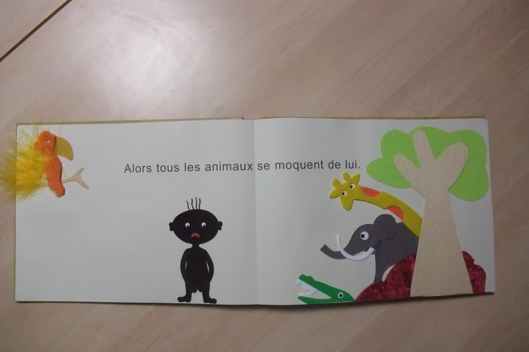

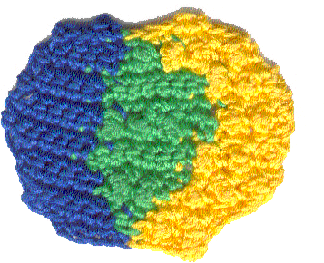
5-Youth literacy TiB (reader)
Ldqr, 2010, Boubou’s underwear, French author
Ldqr, 2011, The big yellow shark, French author
Crochet
Ldqr, 2006, Little Yellow, Little Blue, L. Lioni (Italy/USA)
©Ph. Claudet, Asahi 2018

Slide 20
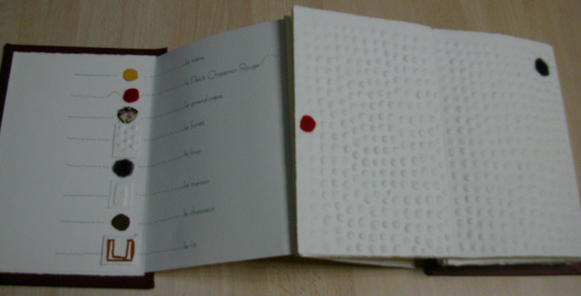
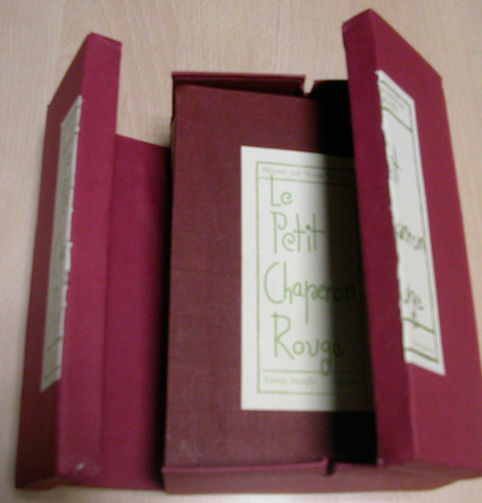
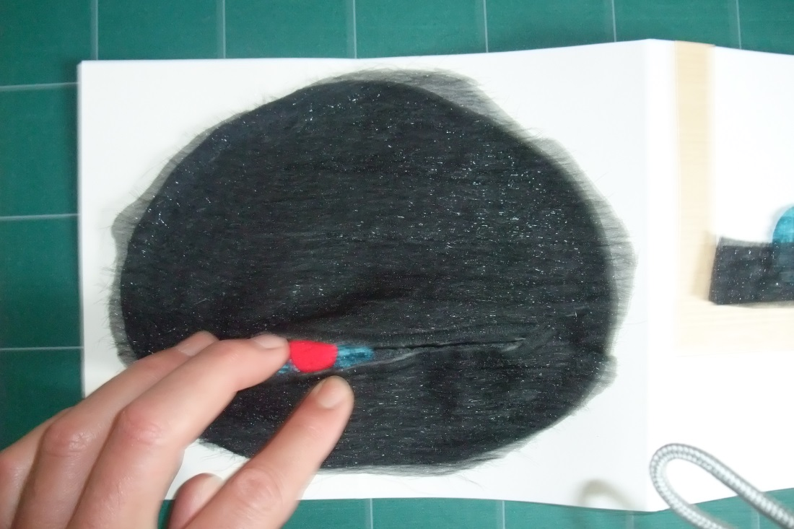
6-Artist TiB
Ldqr 2009, Little Red Riding Hood , Author: Warja Lavater (Switzerland)
©Ph. Claudet, Asahi 2018

Slide 21
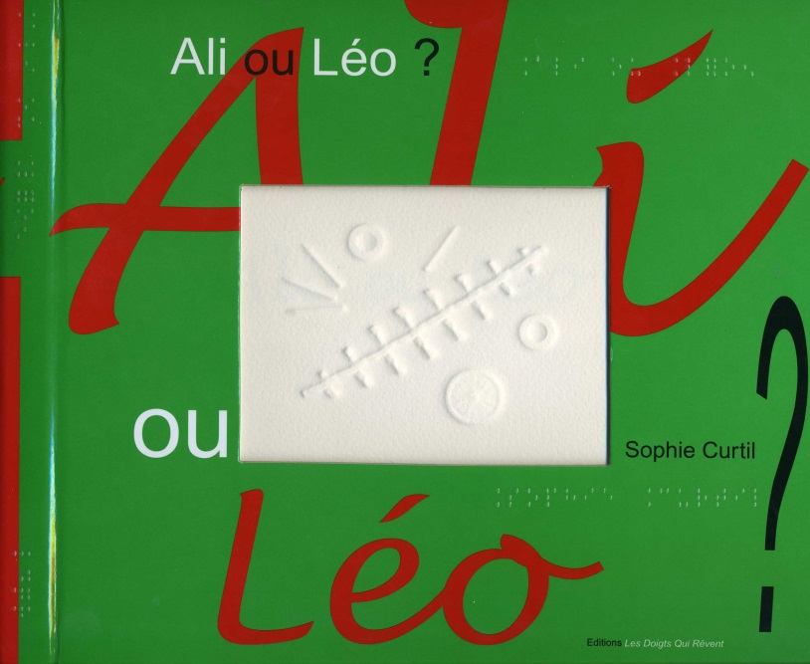
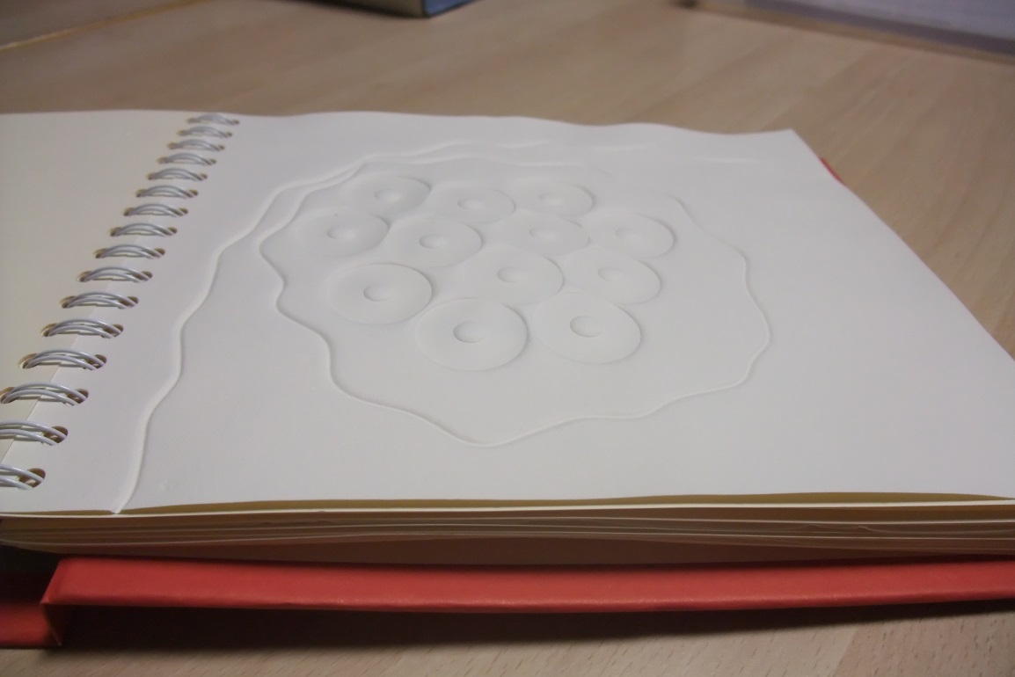
6-Artist TiB
Ldqr, 2004, 2011, Ali ou Léo,
by Sophie Curtil (French author)
Embossed pictures
21x29,7cm (8.5 x 12 inches)
©Ph. Claudet, Asahi 2018

Slide 22
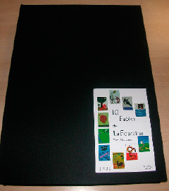
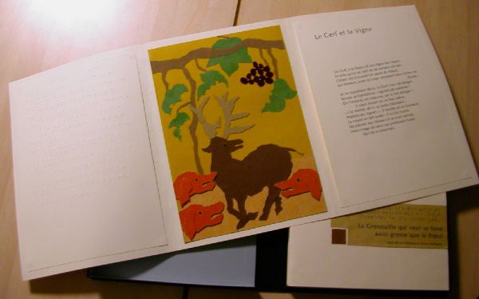
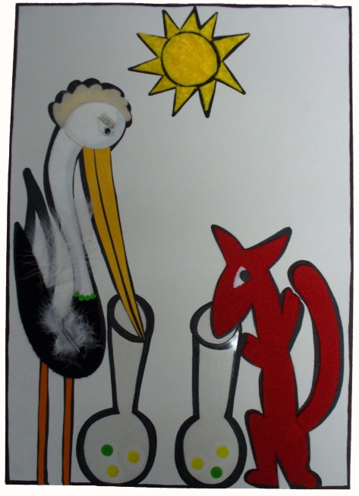
6-Artist TiB
A3
A3
A3
Ldqr, 2009, Ten Fables of La Fontaine illustrated by 10 artists
Braille
Size: 29,7x42cm (16.5 x 11.8 inches)
©Ph. Claudet, Asahi 2018

Slide 23
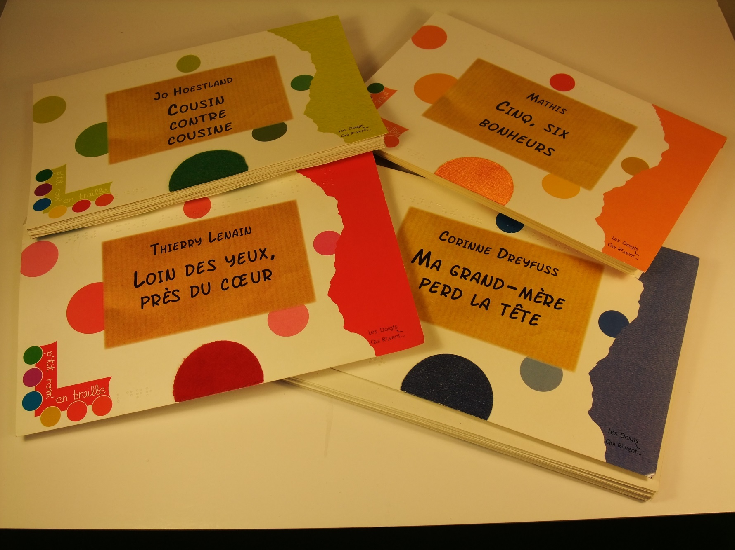
7-Short novels (Large print & Braille 1, without illustrations)
16x25cm (6.2 x 9.8 inches), 45 pages
©Ph. Claudet, Asahi 2018

Slide 24
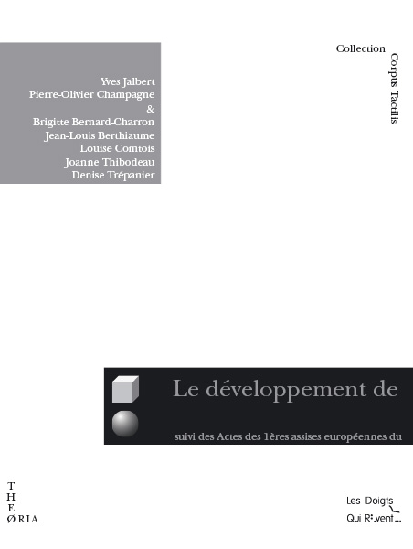
8-Essays for parents & professional
Corpus Tactilis Collection
• 43 titles (since 2008)
translated from:
• Brasil, Canada, Czech Rep., Denmark, England, Germany, Italy, Netherlands, Scotland, Spain, Sweden, United-States
• translators are retired language teachers (and me), all volunteers
21x16 cm
©Ph. Claudet, Asahi 2018

Slide 25

9-Terra Haptica (journal for professionals, researchers and parents)
1/year
3 sections: Research, practice, art
177 pages, colours, A4
©Ph. Claudet, Asahi 2018

Slide 26
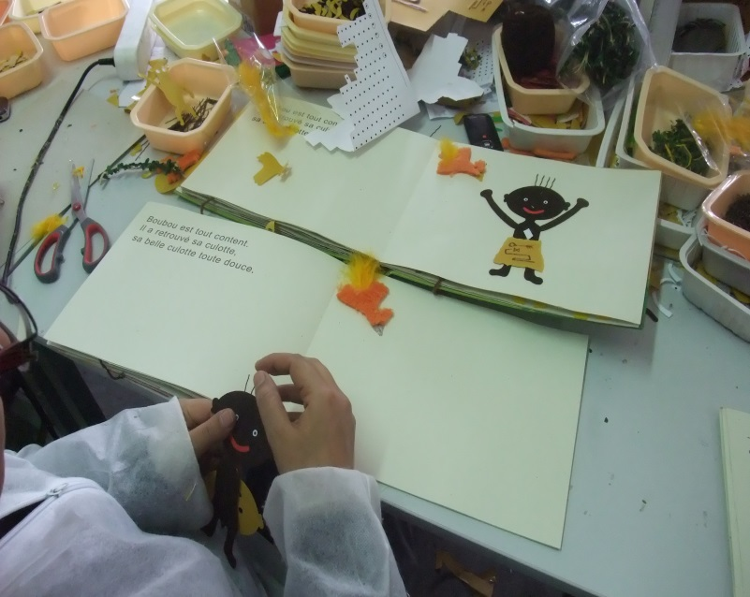
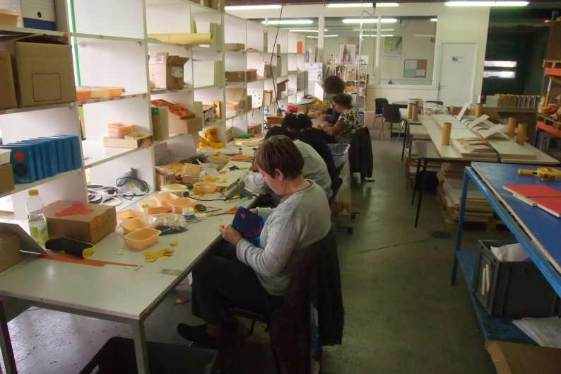
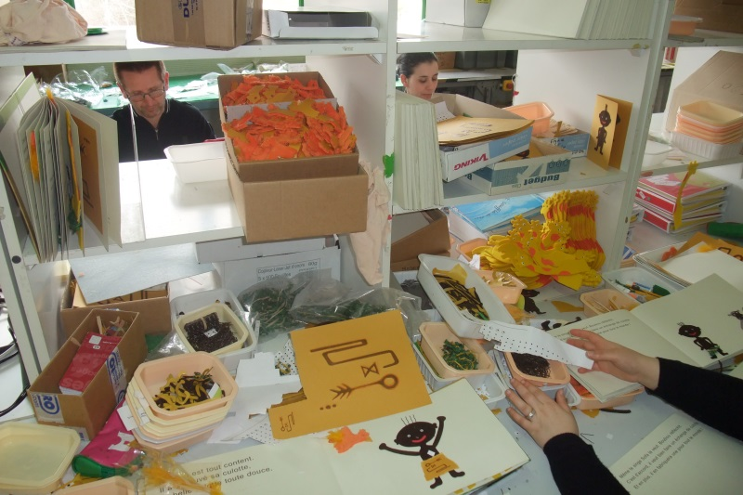
How do we work?
Conception and administration
-7 salaries
Production (handwork)
-long term unemployed people
-volunteers (retired women)
= 25 persons
©Ph. Claudet, Asahi 2018

Slide 27
How are we organized
Needs of
professional & parents
Prototype sent by professional
Multi disciplinary group
Research
(Psychology, Philosophy, Semiotic, Cultural studies…)
Production prototype made by Dreaming Fingers
> 8 months
Test
Modifications
Production
> 8 months
©Ph. Claudet, Asahi 2018

Slide 28
TiB in figures
Since 1994 : 255 titles = 50 000 TiB produced (all languages combined)
80 % creation, 20% adaptation of commercial books
Handwork average time/copy = 3h30
Cost distribution : 70% handwork, 15% print,
10% material, 5% administration
Distribution : 45% in public libraries (= social integration)
45% schools & parents
10% art collectors
➔ To produce 1 TiB = 135€ (average)
➔ Selling price/TiB = 65€ (average)
➔ Selling price/TiB for parents = 30€
©Ph. Claudet, Asahi 2018

Slide 29
TiB in figures
As we are the unique workshop to produce TiB illustrated by collage, we are asked to produce for other countries
➔
Italy (1 title = 800 ex)
➔
Germany (12 titles = 2000 ex)
➔
United-States (10 titles = 3100 ex)
➔
Portugal (1 title = 200 ex)
➔
Netherlands (7 titles = 125 ex)
©Ph. Claudet, Asahi 2018

