Slide 1
Radio Workshop
for
Young People
”BRIDGES”

Slide 2
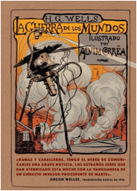
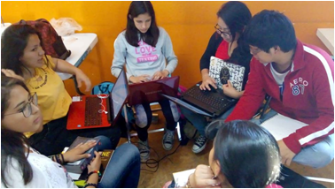
Scriptwriting
Creative writing: children write spontaneously what they think about a certain topic.
They share their reading with the team, comment on their impressions and
then, with a broader idea of ​​the topic,
they generate a radio script
for the next broadcast
Creation of literary script through the recreation of the radio broadcast:
"War of the Worlds",
by Orson Welles.

Slide 3
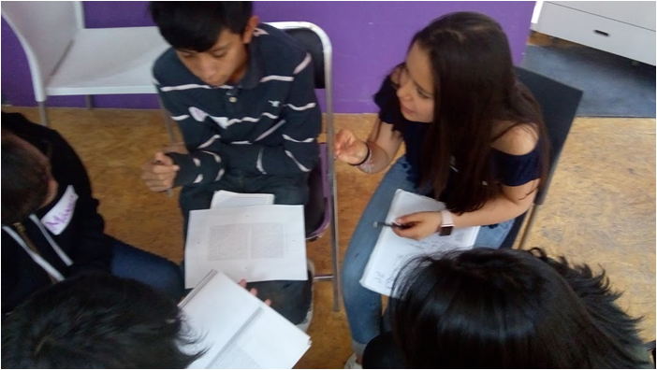
Ingredients to develop themes in each radio broadcast
Collaborative work: Each member assumes a specific function Communication: The members discuss possibilities and make agreement

Slide 4
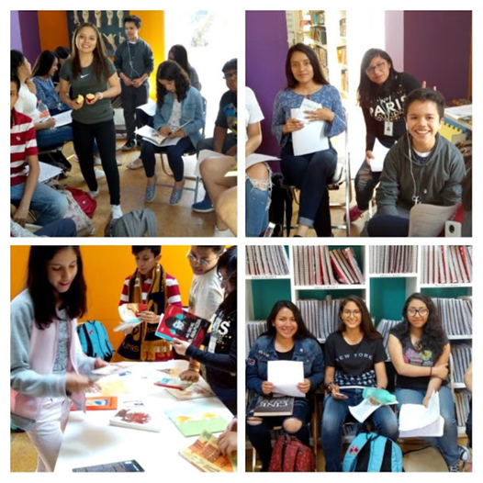
Information research
Collaborative work: Each member assumes a specific function Communication: The members discuss possibilities and make agreement

Slide 5
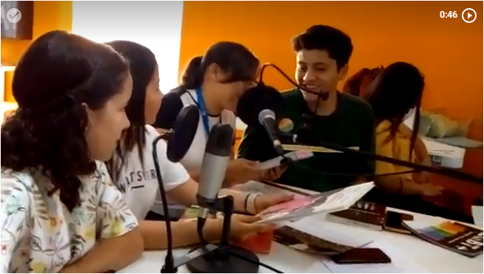
Reading recommendations
They prepared themselves by consulting some books in the library, which they recommended to listeners.
One of the topic of interest was Homophobia. They spoke about what they know in relation to the terms gay, lesbian, homosexual, transgender, etc.
They made reflections oriented to issues such as: respect and identity, and emphasized the need to accept differences between people.

Slide 6
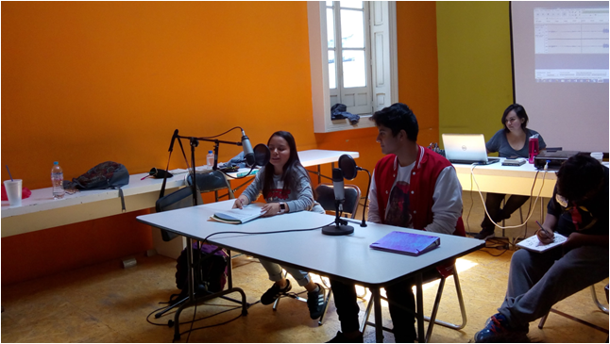
Creative Writing Process
The process of creative writing has been developed around proposed themes by the young participants.
Falling in love is a subject that has prevailed

Slide 7
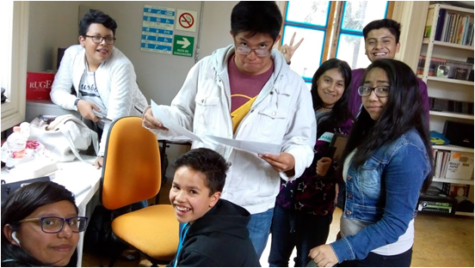
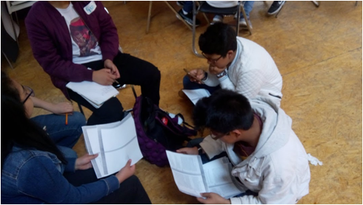
Script
The young participants create a script related to the experiences that are meaningful to them. They then record and perform the audio edition to insert the podcast in the radio broadcasts of IBBY Mexico.

Slide 8
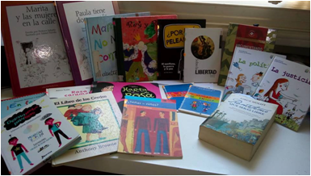
Books selection
The selection of books has been fundamental, not only to develop topics that will be commented on a radio broadcast, but also for the creation of podcasts in which they recommend the titles they like the most.

Slide 9
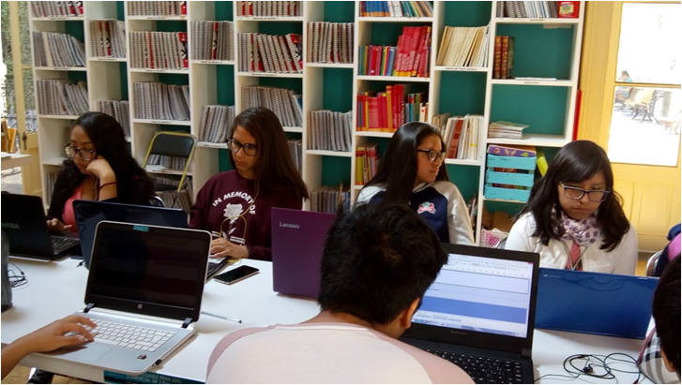
Other reading supports
The youngsters have access to web 2.0., where they have found other reading alternatives that are also significant to them.
They generate podcasts of book reviews that will be heard by other children and young people.

Slide 10
Goya 54
Col. Insurgentes Mixcoac
Ciudad de México
5211-0492/ 9545
www.ibbymexico.org.mx

